Slide 1
Principles of Management
Meaning, Objectives, Differences between Administration and Management, Levels of Management, Kinds of Managers, Managerial roles, History of Management, Contemporary issues in Management.
.

Slide 2
Meaning and Definition
Management is the art of maximizing efficiency, as a social process, a method of getting things done through others a plan of action and its direction by a co-operative group moving towards a common goal. Effective utilisation of available resources to achieve same objective is management.
Management is a comprehensive function of Planning, Organising, Forecasting Coordinating, Leading, Controlling and Motivating.
Notes:
Management is the art of maximizing efficiency, as a social process, a method of getting things done through others a plan of action and its direction by a co-operative group moving towards a common goal. Effective utilisation of available resources to achieve same objective is management. Management is a comprehensive function of Planning, Organising, Forecasting Coordinating, Leading, Controlling, Motivating

Slide 3
According to George R Terry, “Management is a distinct process consisting of planning, organising, actuating and controlling performed to determine and accomplish the objectives by the use of people and resources”.
According to Koontz and O’Donnel, “Management is defined as the creation and maintenance of an internal environment in an enterprise where individuals working together in groups can perform efficiently and effectively towards the attainment of group goals”.
According to Peter F Drucker, “Management is a multi-purpose organ that manages a business and manages managers and manages worker and work”.

Slide 4
Nature of Management:
“Management is both a Science as well as an Art”
‘Science’ refers to :
It is a systematized body of knowledge and uses scientific methods for observation.
Its principles are evolved on the basis of continued observation and experiment.
Its principles are exact and have universal applicability without any limitation.

Slide 5
‘Art’ refers to :
1. Art is the application of science. It is putting principle into practice.
2. After knowing a particular art, practice is needed to reach the level of perfection.
3. It is undertaken for accomplishing an end through deliberate efforts.

Slide 6
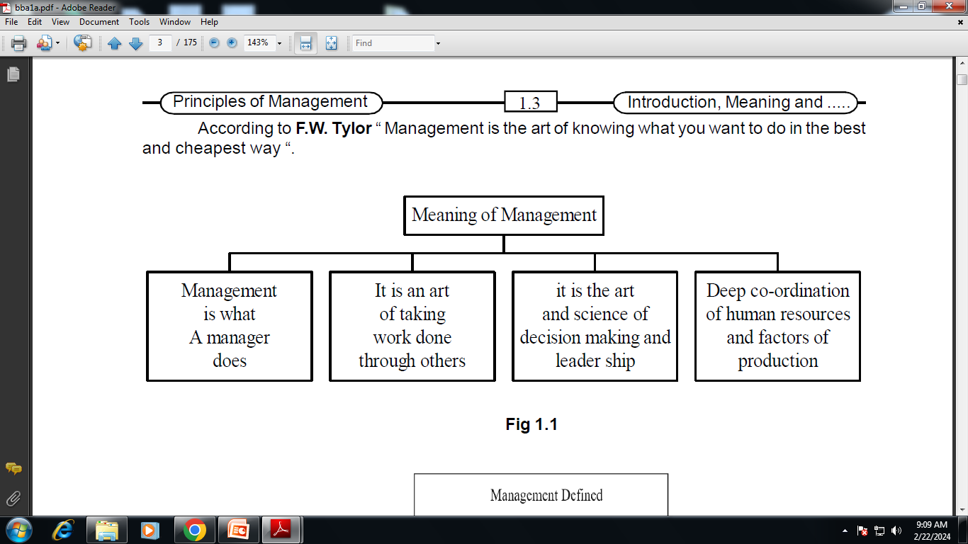
In Short,

Slide 7
Objectives or Significance of Management
Determination of Objectives.
Create a path to achieving of objectives.
Meeting challenges.
Provides innovation.
Smooth running of business.
Optimum utilization of Resources.
Role in national economic development

Slide 8
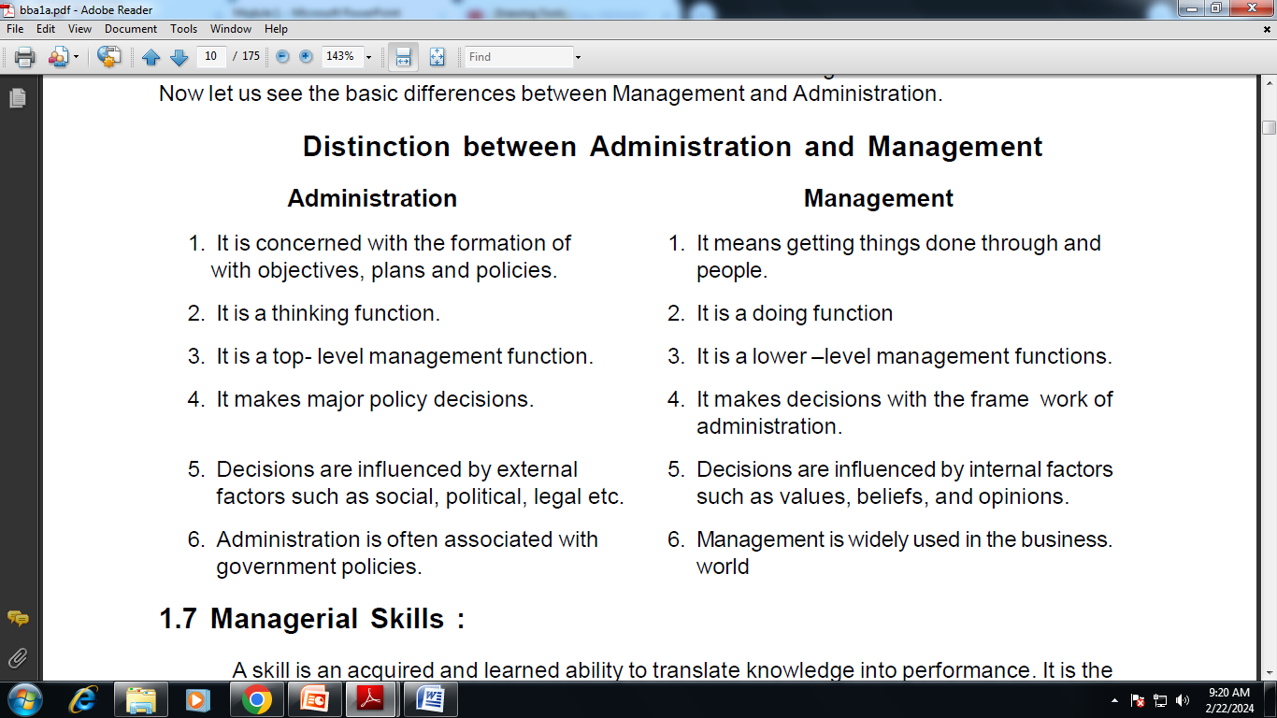
Administration v/s Management

Slide 9
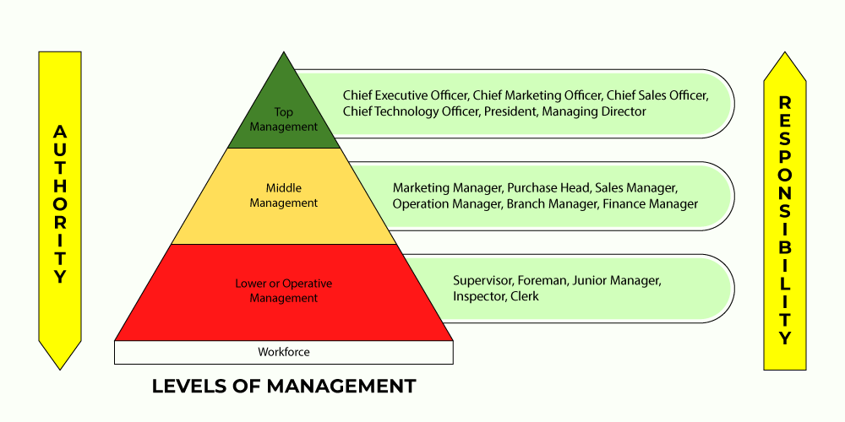
Levels of Management

Slide 10
Managerial roles
As per Henry Mintzberg’s every manager, plays roles in three areas :
1. Inter personal Relationships.
(As a Figure head, Leadership role, Liason officer)
2. Information processing.
(Monitoring Information, Disseminating Information, Organisations Spokesman)
3. Decision Making.
(As an Entrepreneur, As a Conflict Handler, As a Resource Allocate, As a Negotiator)

Slide 11
Contemporary issues in Management :
Remote Working Management.
Employee Well being.
Diversity and Inclusion
Sustainability.
Change Management.
Ethical Dilemmas.

Slide 12
Advanced Intervention of Technology.
Continuous Learning.
Data Driven Activities.
New Leadership Styles.
Globalisation (Cultural Dimensions).
Talent Management.
Digitization.

Slide 13
Thank You …
Read more at:
https://economictimes.indiatimes.com/jobs/c-suite/the-future-of-leadership-trends-and-skills-to-develop-through-management-courses/articleshow/103363764.cms?utm_source=contentofinterest&utm_medium=text&utm_campaign=cppst
https://www.youtube.com/watch?v=azoMYRJ0oB0
https://www.slideshare.net/slideshow/contemporary-issues-of-management/244605492

